Slide 1
Te’mexw Treaty Association & Esquimalt Nation Negotiations
Presentation to City of Victoria
Feb 23, 2023
Notes:
Territorial acknowledgement

Slide 2
PRESENTERS
Ministry of Indigenous Relations and Reconciliation
Rebecca Penz, Director of Consultation and Engagement
Stephen Winn, Negotiator
Crown-Indigenous Relations and Northern Affairs Canada
Michael Blackburn, A/Director of Negotiations, Vancouver Island
Gwyn Thomas, A/Negotiator

Slide 3
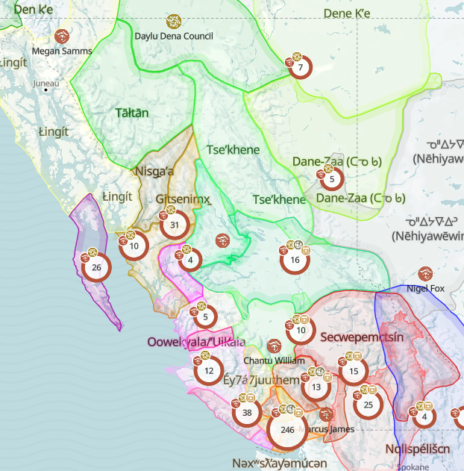
Indigenous Peoples in BC
270,000+ Indigenous people in BC
First Nations, Métis and Inuit
204 First Nations in B.C. (600 in Canada)
Culturally and linguistically diverse
34 distinct languages and 90 dialects
Sophisticated cultures, relationships and systems of laws

Slide 4
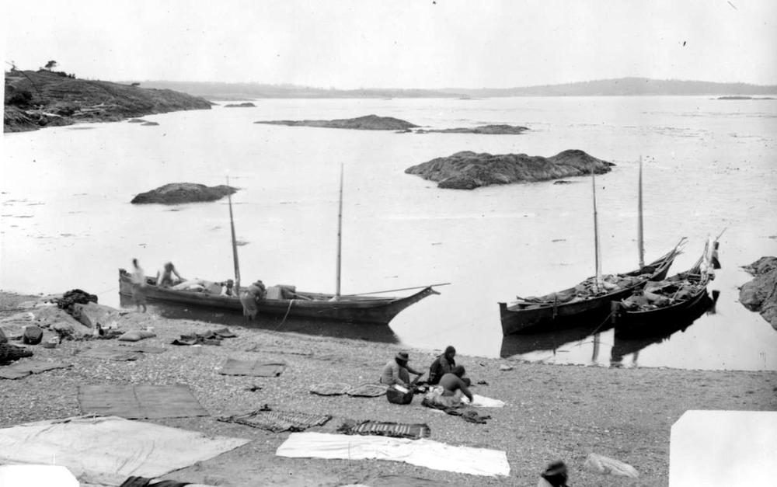
Historic Treaties in BC
Few historic treaties:
Douglas Treaties, Vancouver Island (1850 – 1854)
Treaty 8, Northeast B.C. (1899)

Slide 5
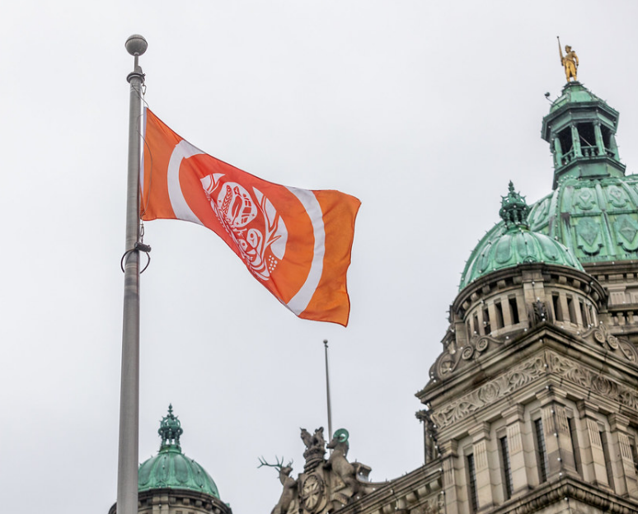
Reconciliation – Why?
Colonial policies and programs, including the Indian Act, Indian residential schools, and the 60s scoop, have impacted all aspects of Indigenous life:
culture and social structures
exercise of rights
access to lands, resources, services and economic opportunities
overall health and wellness (including inter-generational trauma and death)
Notes:
Note the shift from a legal imperative, grounded in Section 35 and addressed through many court decisions, to a human rights imperative.

Slide 6
Reconciliation – What?
A paradigm shift in thinking and action that involves:
Recognition of on-going presence and rights of Indigenous peoples in B.C.
Supporting strong and healthy communities
Advancing self-determination
Addressing past and on-going harms and healing
Ultimately, it’s about partnering with Indigenous Nations to make a better BC

Slide 7
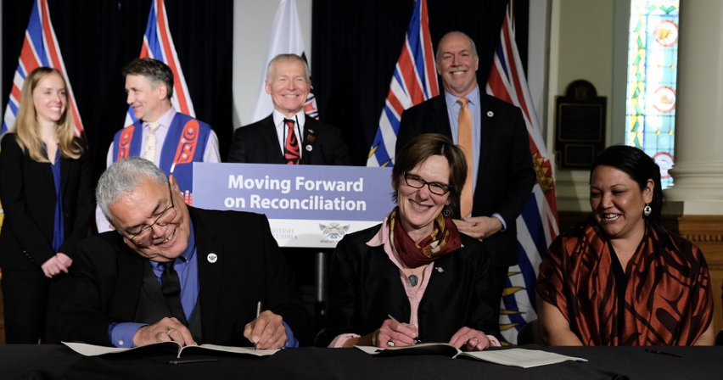
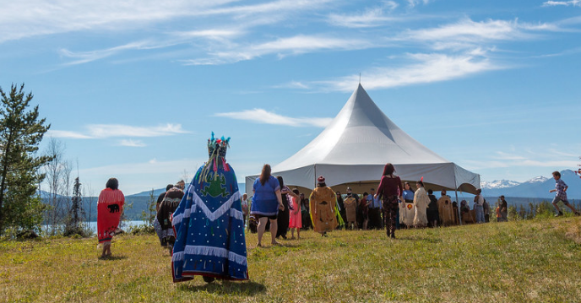
Reconciliation – How?
An ongoing, dynamic journey
Flexible, responsive, context-specific (no one size fits all)
Renewed fiscal relationship
Negotiating long-term agreements
Self-determination
Economic independence
Shared initiatives to improve quality of life
Partnering to manage land and resources

Slide 8
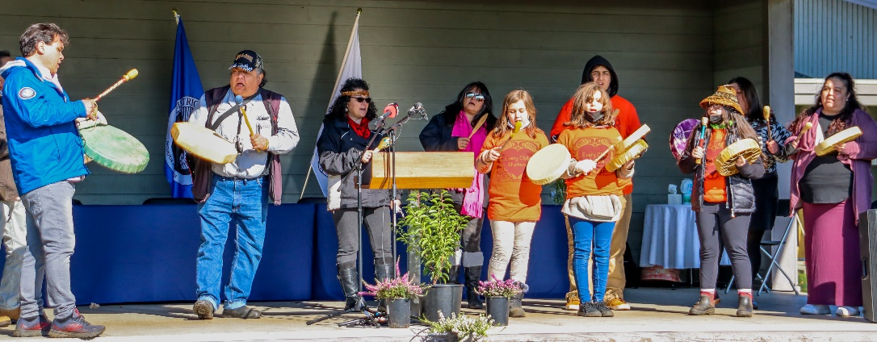
United Nations Declaration on the Rights of Indigenous Peoples (UNDRIP) & the Declaration Act
2007
Adopted by UN General Assembly
2016 & 2017
Canada and B.C. support UNDRIP
2021
Adopted by Canada under UNDRIP Act
2019
Adopted by BC under the Declaration Act
Comprehensive human rights instrument that recognizes Indigenous peoples' right to self-determination and to “freely pursue their economic, social and cultural development”
Notes:
The Declaration Act
Align laws with the United Nations Declaration
Develop & implement action plan (released Mar 2022)
Report & monitor on progress
Decision-making agreements

Slide 9
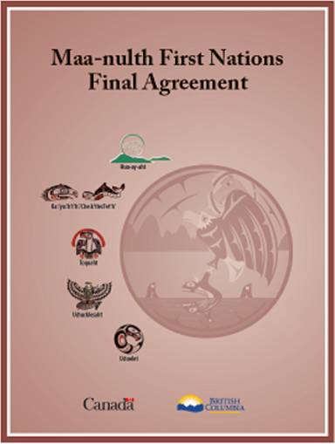
Modern Treaties in BC
Most comprehensive form of reconciliation
Since 2000, 4 treaties implemented (8 FN)
New treaties are living agreements

Slide 10
Te’mexw Treaties Overview
Five Nations—Malahat, Beecher Bay (SC’IA/NEW), Songhees, Snaw-naw-as (Nanoose), T’Sou-ke—are negotiating treaties at a common table
These treaties are intended to encourage investment, create jobs, expand economic development, and support social well-being for Te’mexw Treaty Nations and the entire Region

Slide 11
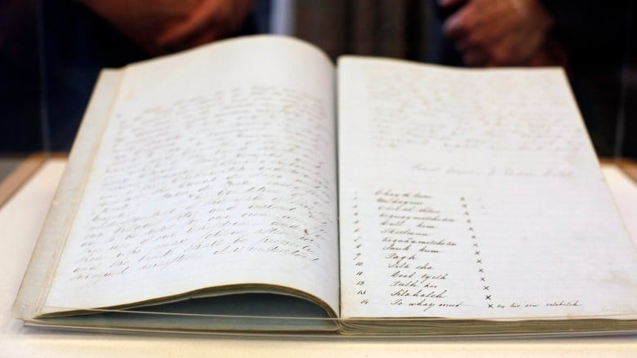
Douglas Treaties
14 treaties around Victoria, Saanich, Sooke, Nanaimo and Port Hardy
Douglas Treaties: First Nations retain right to fish and hunt as per formerly (held up in Court)
New agreements (treaties, reconciliation agreements, etc.) will co-exist with Douglas Treaties

Slide 12
Negotiations Timeline
Notes:
Five First Nations, Five treaties, common table.

Slide 13
Overview
These treaties will:
Recognize pre-existing rights and title of First Nations
Return lands to First Nations
Establish First Nations self-government
Provide predictability
Provide ongoing governance funding
Include a one-time cash transfer
Create opportunity for the power of taxation by the First Nation on their treaty land
Support intergovernmental relationships with local/regional government
Identify co-management/shared decision-making opportunities in Te’mexw territories

Slide 14
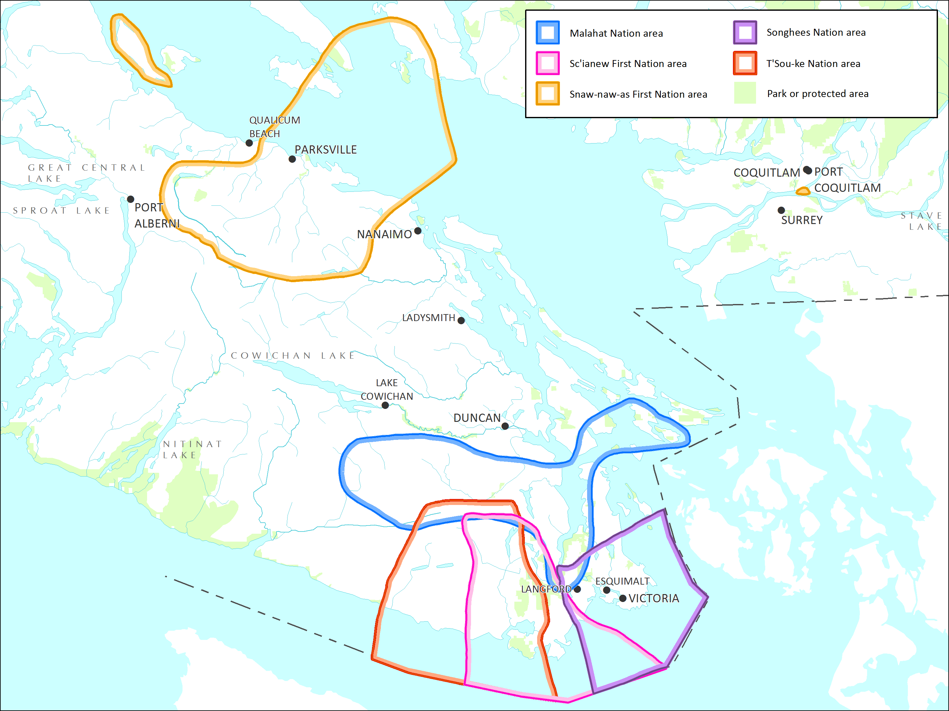
Statement of Intent:
First Nations Identified Territory
Notes:
Territories extend south of the Canadian border

Slide 15
Proposed Treaty Lands
The following maps show lands proposed to become Treaty Lands for the five Te’mexw Nations.
The land package depicted on these maps is subject to conclusion of the Te’mexw Treaty negotiations and fulfilling consultation obligations.

Slide 16
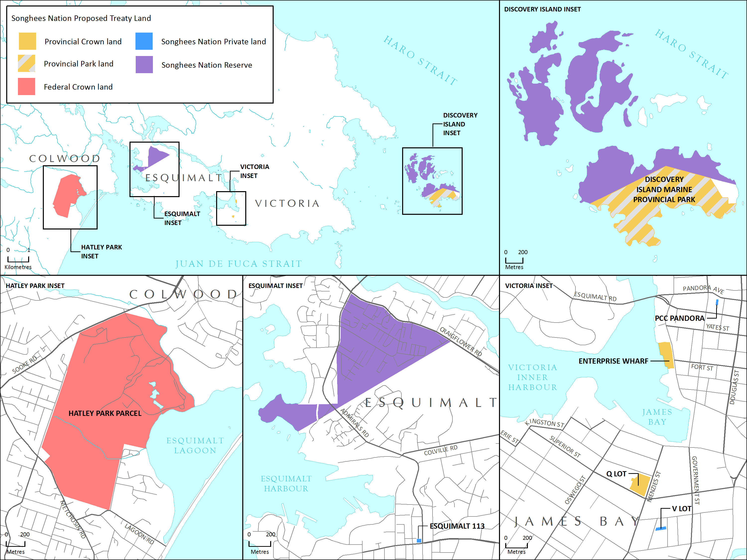
Songhees Nation:
Proposed Treaty Lands

Slide 17
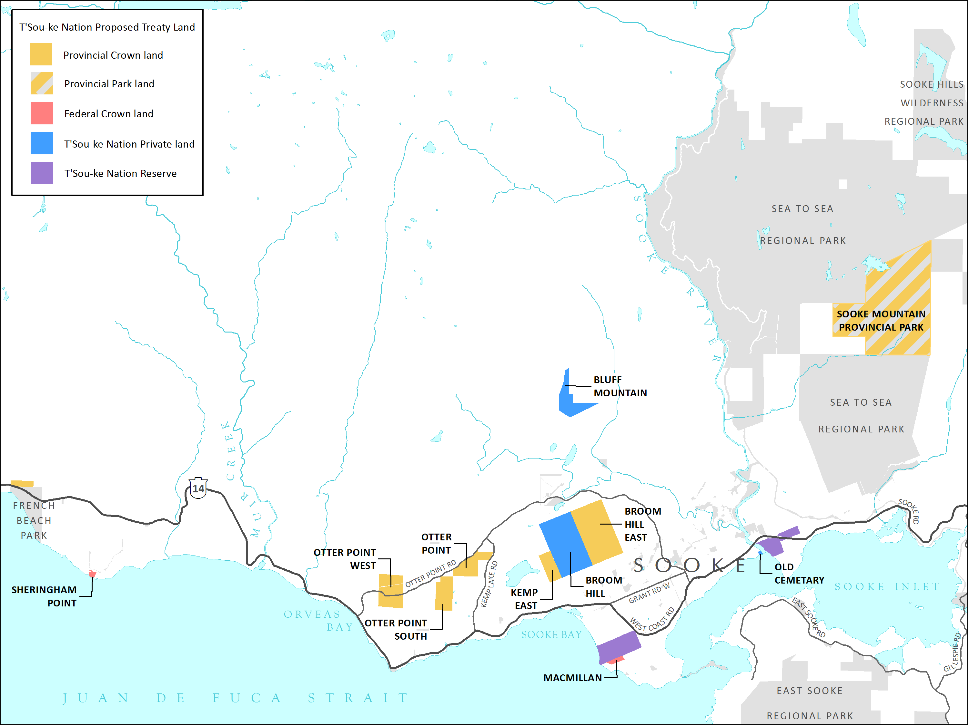
T’Sou-ke Nation:
Proposed Treaty Lands

Slide 18
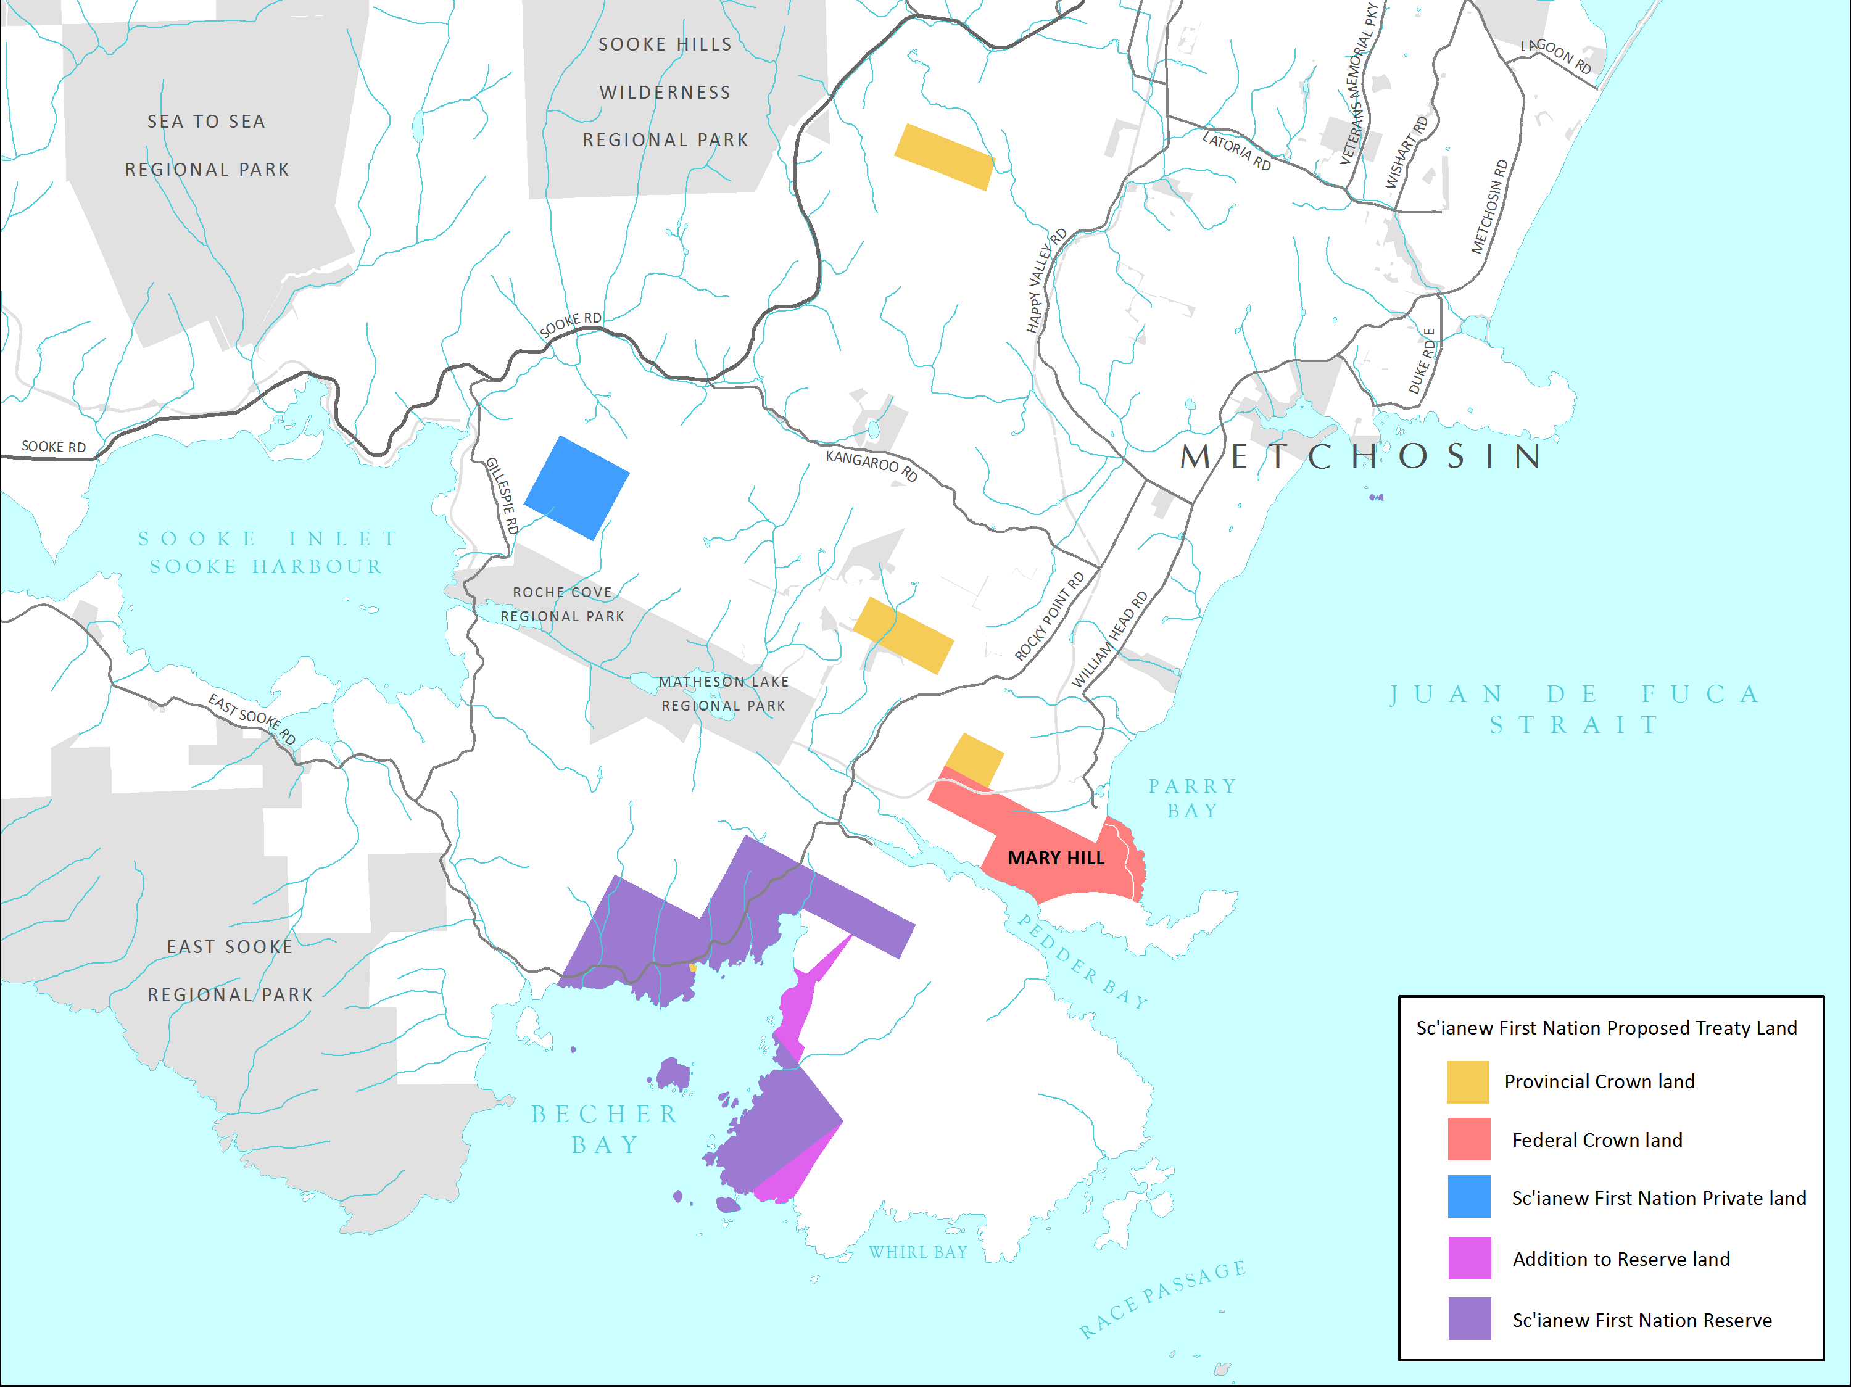
Beecher Bay (SC’IA/NEW):
Proposed Treaty Lands
Notes:
In 2017, a land swap/boundary adjustment agreement was reached between the Beecher Bay (SC’IA⁄NEW), Langford, and Metchosin.

Slide 19
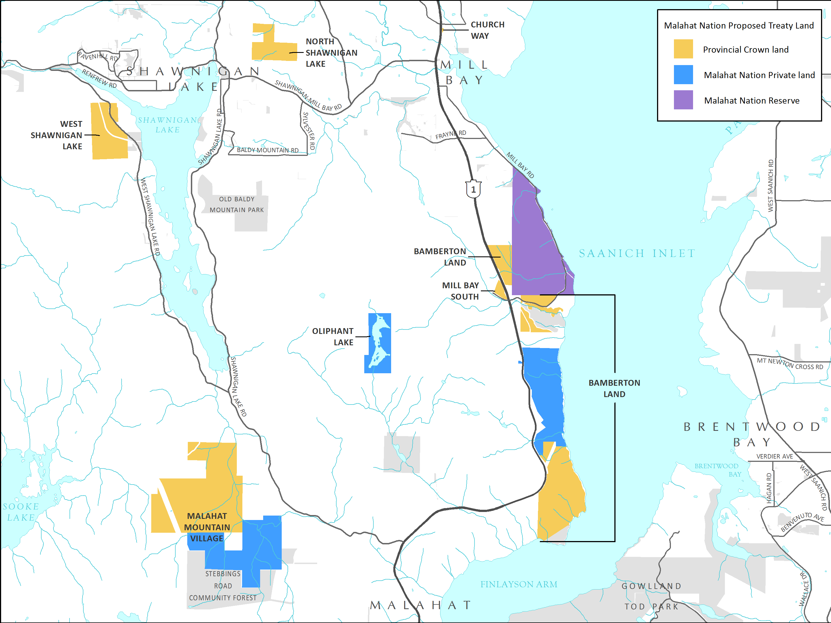
Malahat Nation:
Proposed Treaty Lands

Slide 20
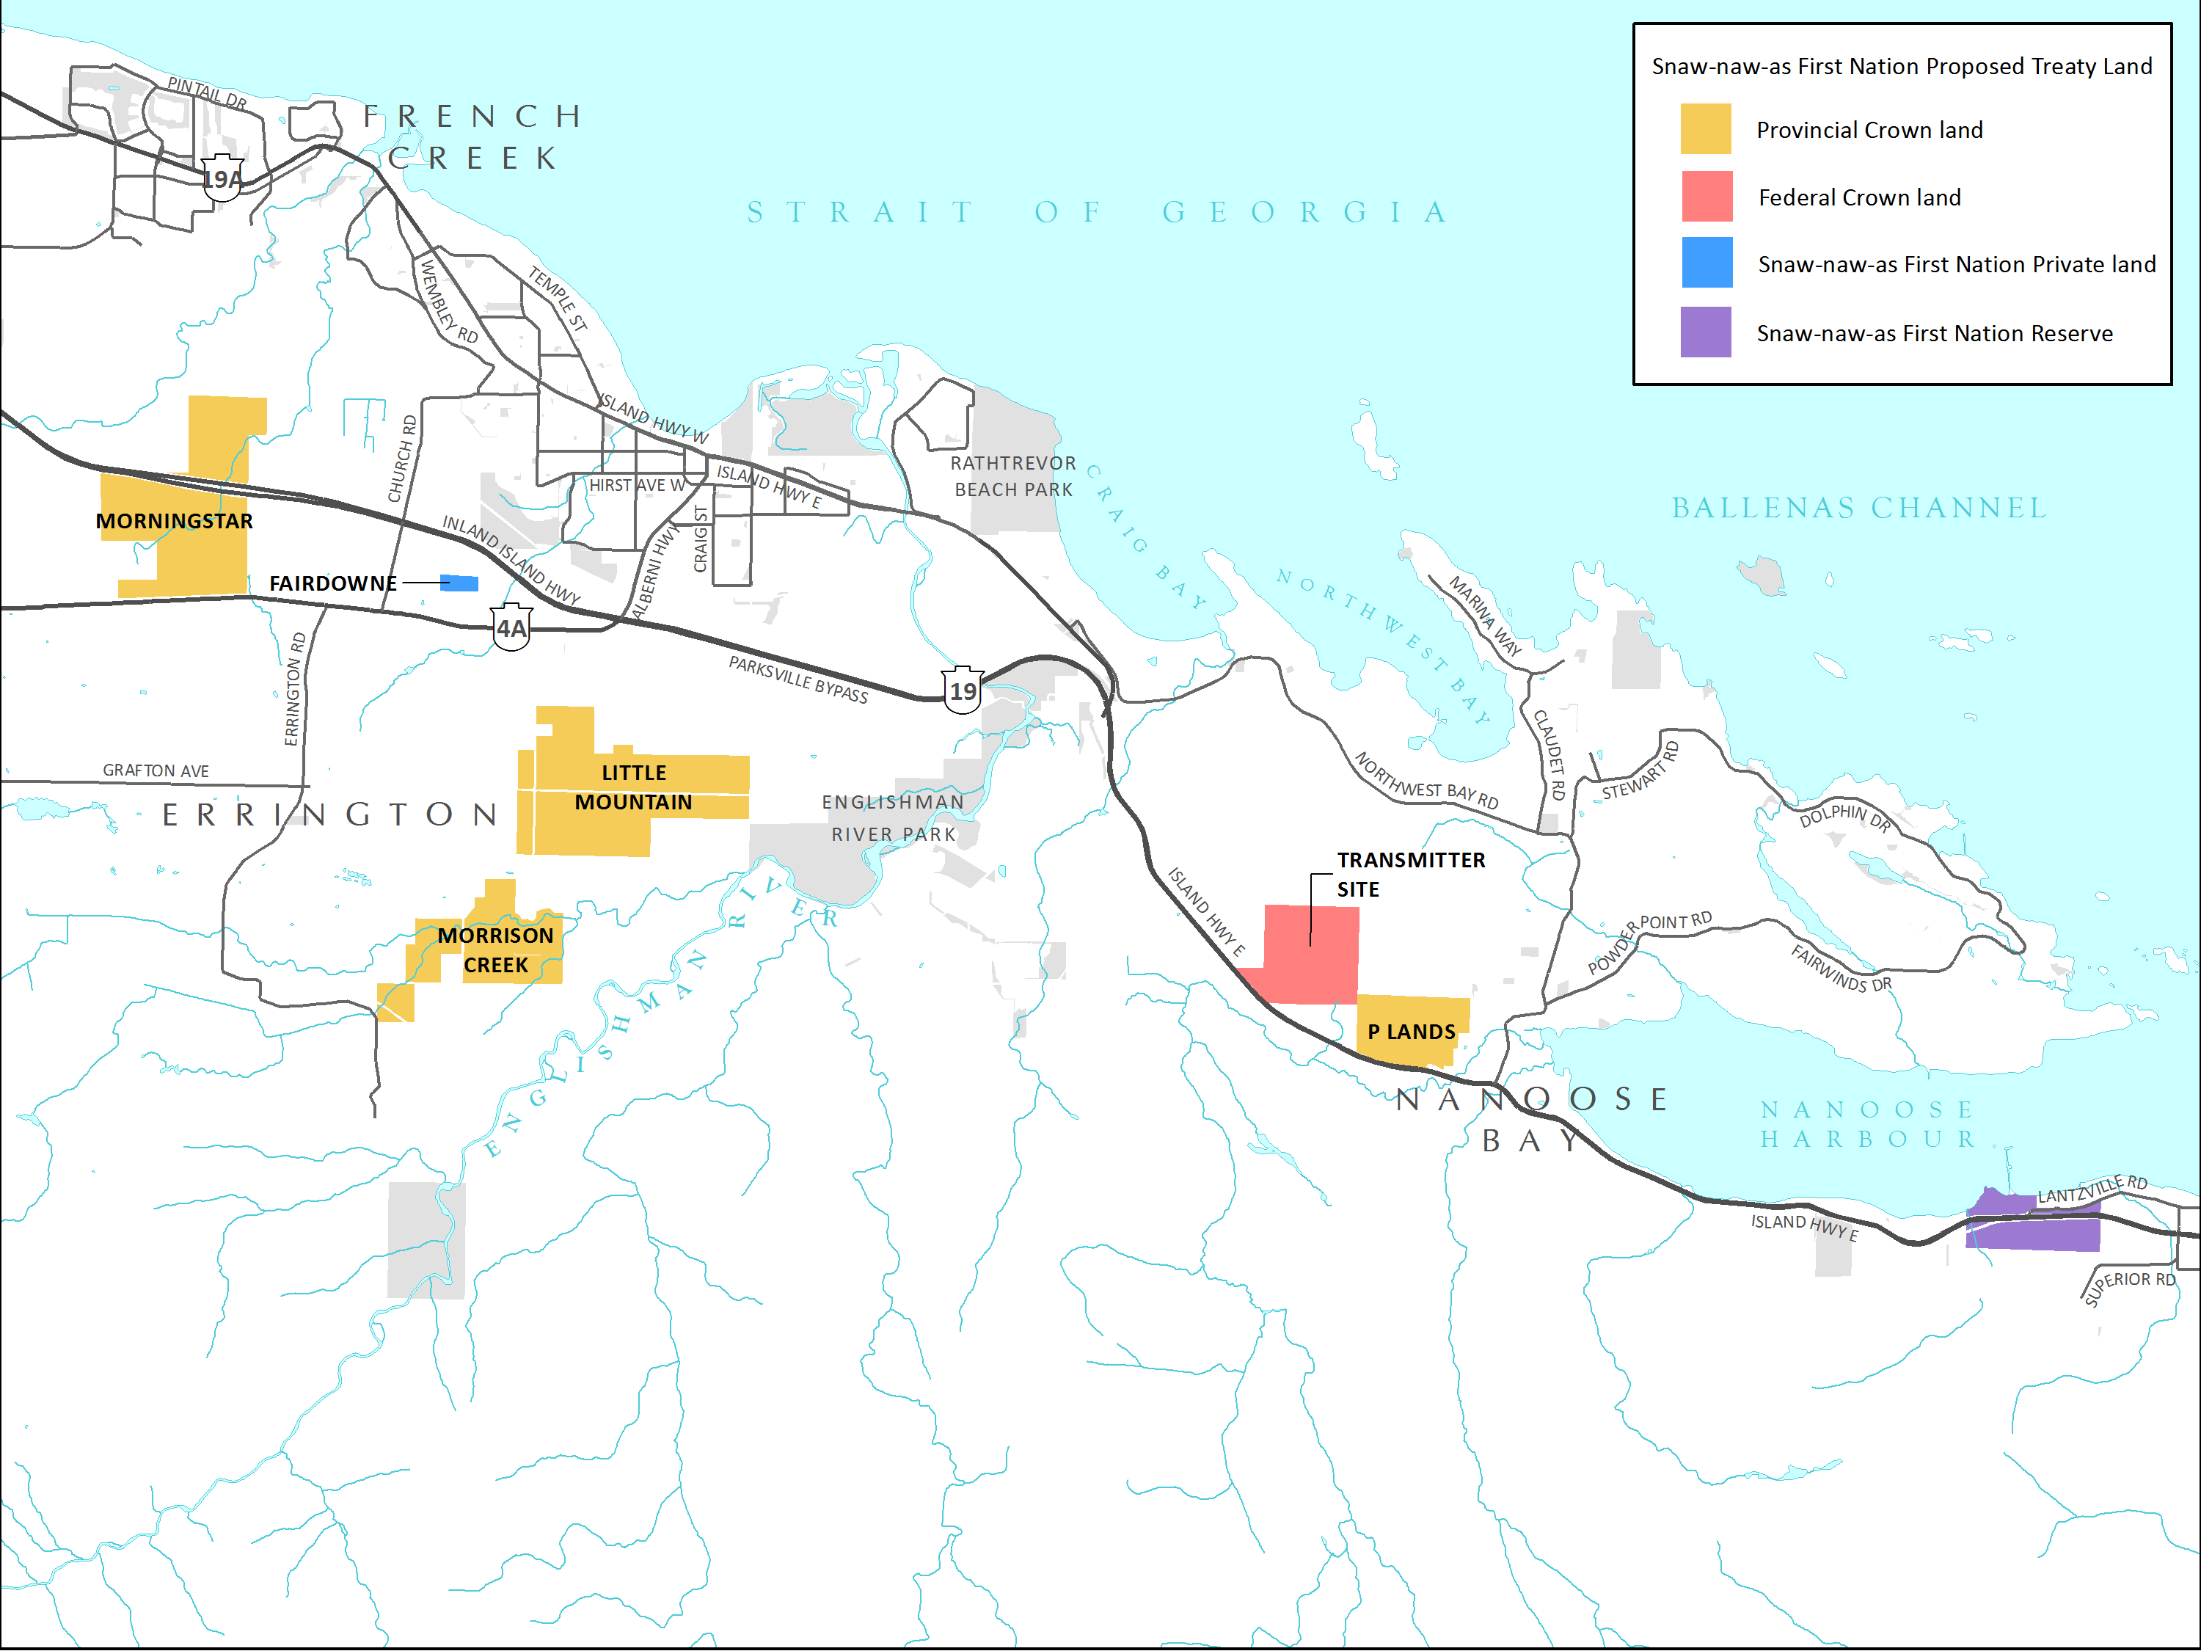
Snaw-Naw-As (Nanoose First Nation):
Proposed Treaty Lands

Slide 21
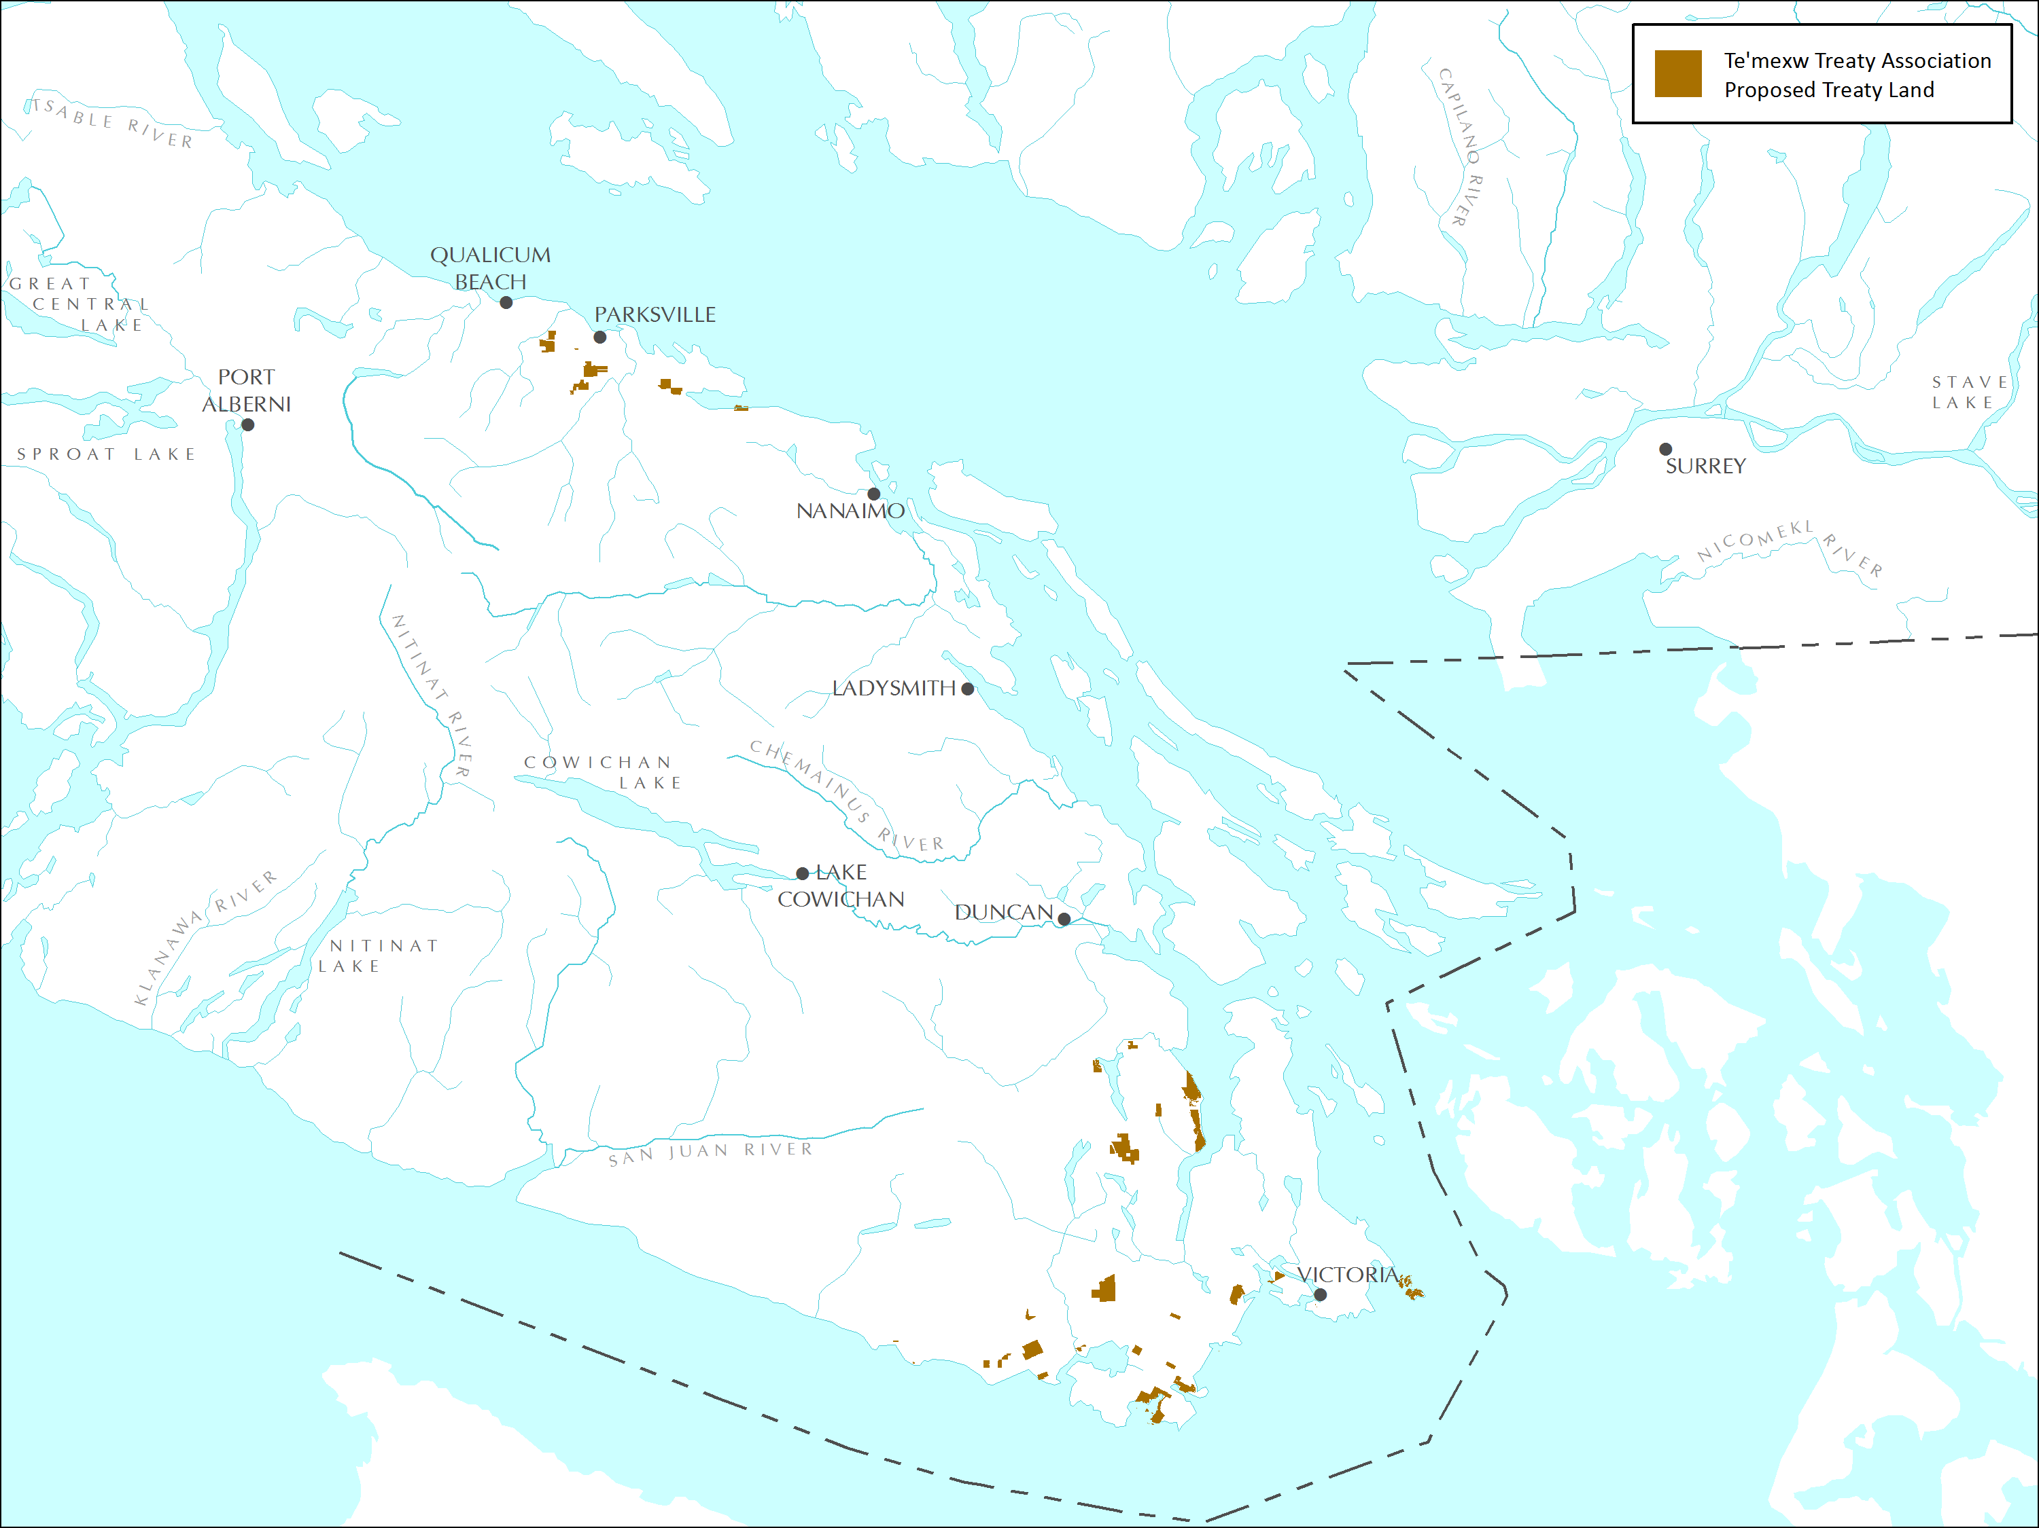
Te’mexw Treaties:
Overview of Proposed Treaty Lands

Slide 22
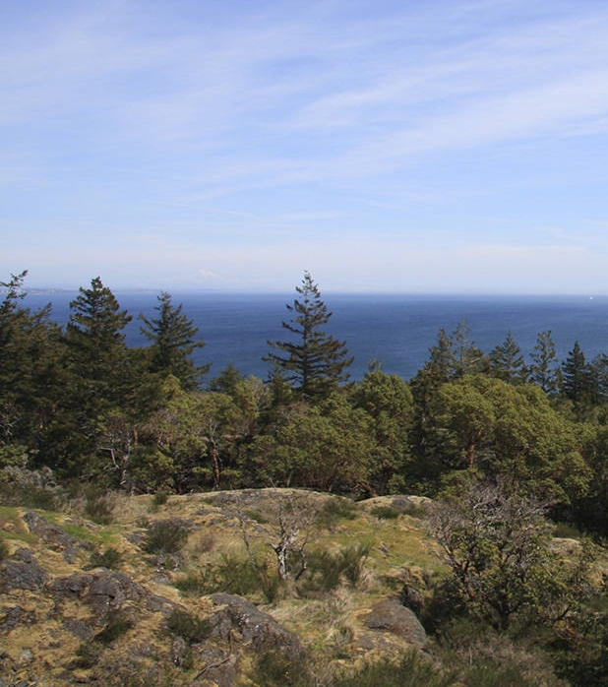
Treaty Lands vs Reserve Lands
Reserve Lands
Owned by federal government
Decision-making limited
Treaty Lands
Owned in fee-simple by Treaty Nation
Treaty Nation government has jurisdiction
All existing reserve lands become Treaty Lands

Slide 23
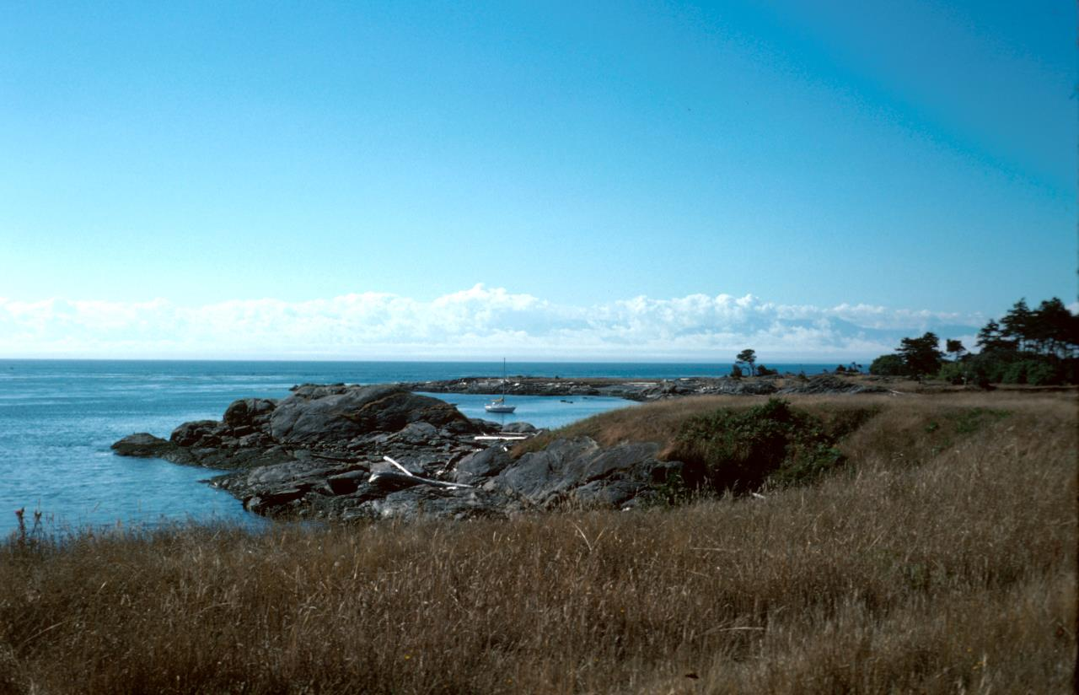
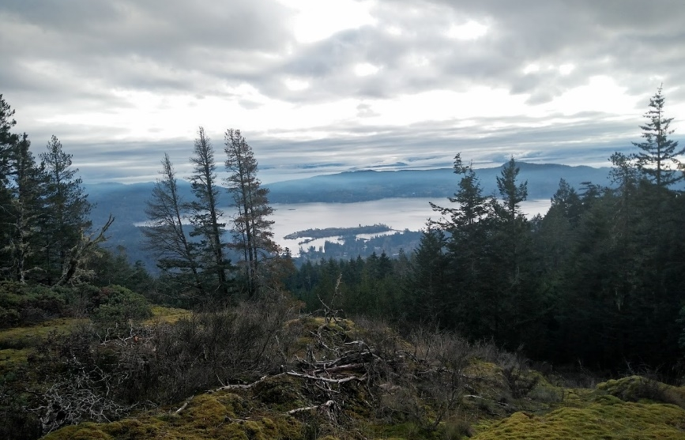
B.C. Parks
Two Provincial Parks under consideration for transfer to First Nations:
Discovery Island as Songhees Treaty Lands
Sooke Mountain as T’Sou-ke Treaty Lands
First Nations agree to maintain public access, conservation values and recreational opportunities

Slide 24
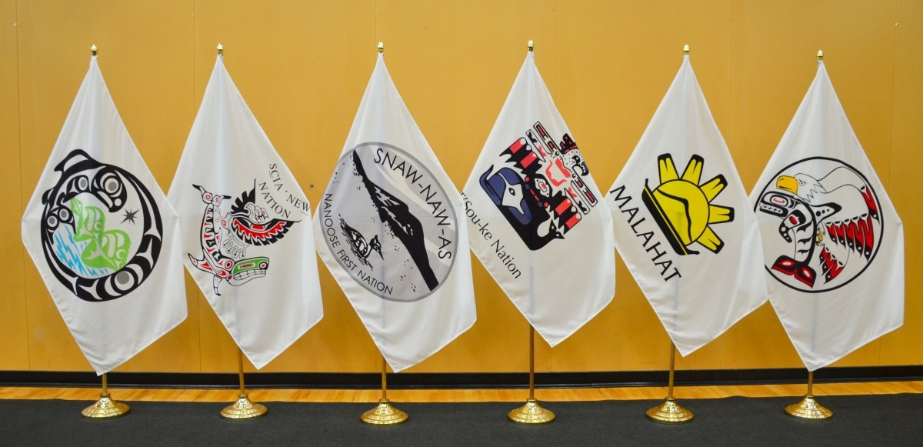
Self-Governance
Inherent right of First Nations to self-govern and make laws (in accordance with treaty)
First Nations may create laws when prepared to exercise authority (otherwise general laws apply)

Slide 25
Law-making Authorities include
Lands and Resources
Adoption
Child protection services
Aboriginal healers
Health services
Family and social services
Marriage
Childcare
Language and Culture
Kindergarten to Grade 12 education
Post-Secondary education
Heritage

Slide 26
Public Engagement
Planning: Oct – Dec 2022
Outreach: Jan – Feb 2023
Engagement: Feb – Apr 2023
Engagement plan
Local gov presentations
Announcement of parks and public engagement
Open houses
Letters/meetings with interest holders and groups
7 in-person
2 virtual
Launch website

Slide 27
Public Open Houses
In-Person
Sat, Feb 25, 11 – 2, Songhees Wellness Centre
Thurs, Mar 2, 4:30 – 7, Sooke, Edward Milne CS
Sat, Mar 4, 11 – 3, Colwood, Royal Roads University
Mon, Mar 6, 4:30 – 7, Nanoose Bay Main Hall
Tues, Mar 7, 4:30 – 7, Victoria, George Jay Elementary
Sat, Mar 11, 11 – 2, Shawnigan Lake Community Hall
Wed, Mar 15, 4:30 – 7, Metchosin Community Hall
Virtual
Wed, Apr 5, 2:30 – 4
Thu, Apr 13, 6 – 7:30

Slide 28
Sign-Up for Te’mexw Treaty Updates:
www.engage.gov.bc.ca/temexw-treaty-negotiations

Slide 29
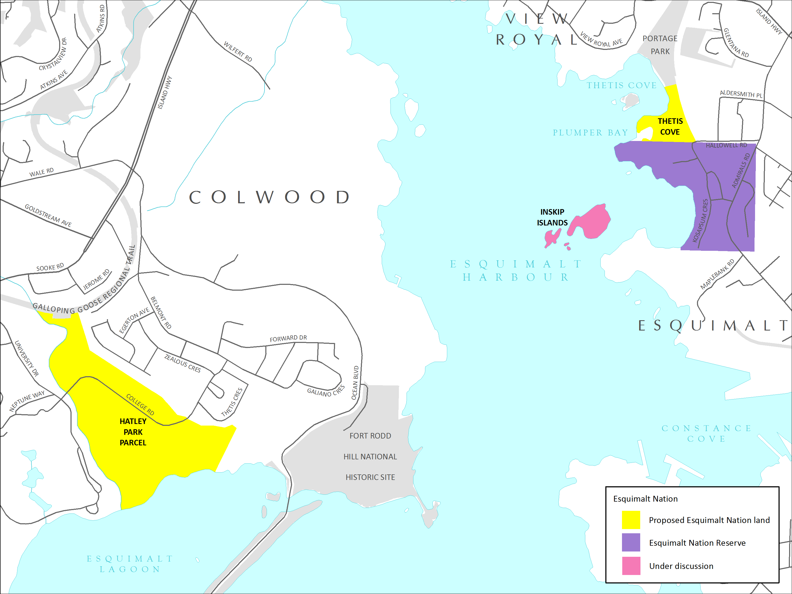
Esquimalt Lands being negotiated as part of a Reconciliation Agreement with Canada and B.C.
Notes:
[Not a TTA Member Nation]. This is a first step towards a more comprehensive reconciliation discussions. Future negotiations with Esquimalt Nation will include governance, shared decision-making and additional lands.

Slide 30
Thank You & Questions!

